Slide 1
BUILDING HIGH PERFORMANCE TECHNICAL TEAMS
Rob Spectre, Director of Devangelism
@dN0t – rob@twilio.com

Slide 2
BUT FIRST

Slide 3
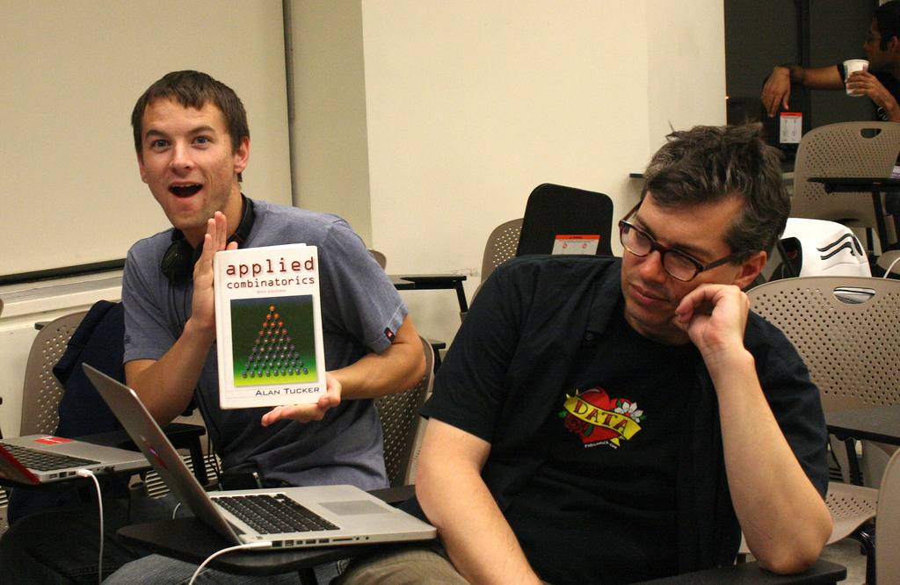
HAPPY BIRTHDAY RANDALL!

Slide 4

heart

Slide 5
THIS IS NOT
A
PRESENTATION

Slide 6

O HAI

Slide 7
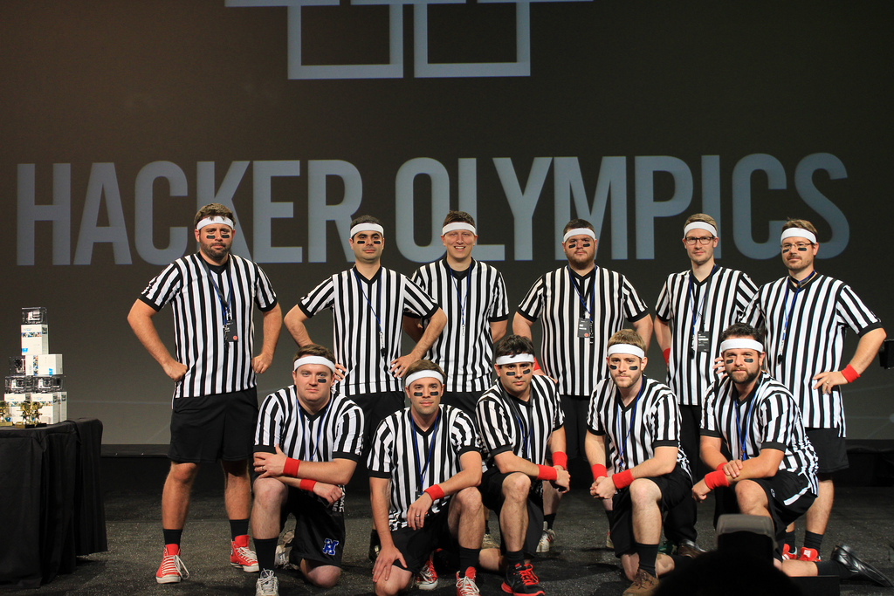
SERIOUS ENGINEERS

Slide 8
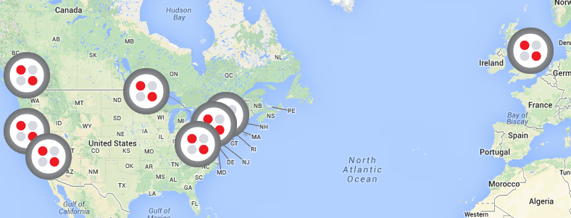
GLOBAL REACH

Slide 9

HOLY SHIT VISUAL BASIC

Slide 10

DC'S BEST SPORTSBALL TEAM

Slide 11
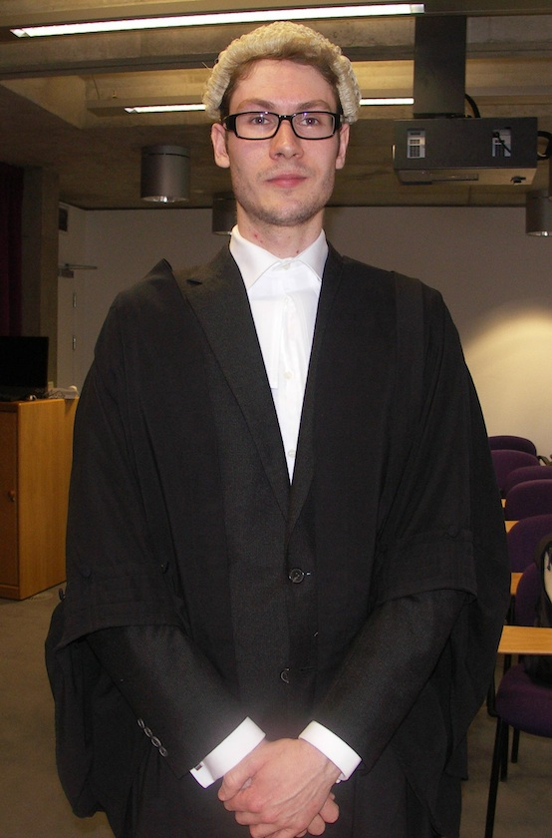
BARRISTERS ARE LEGIT

Slide 12

SUPER HAPPY DEV HOUSE

Slide 13
SERIOUS ENGINEERS

Slide 14
THE PROBLEM

Slide 15
18.2 MILLION
Source: “Global Developer Population and Demographic Study v. 1”, Evans Data Corporation, 2013.

Slide 16
UNITED STATES 3.6M

Slide 17
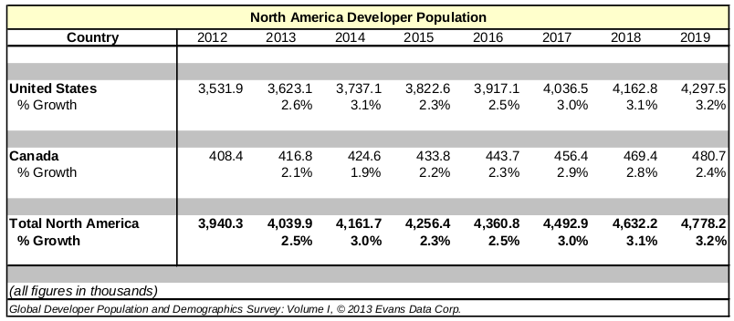
GROWTH PROJECTIONS

Slide 18
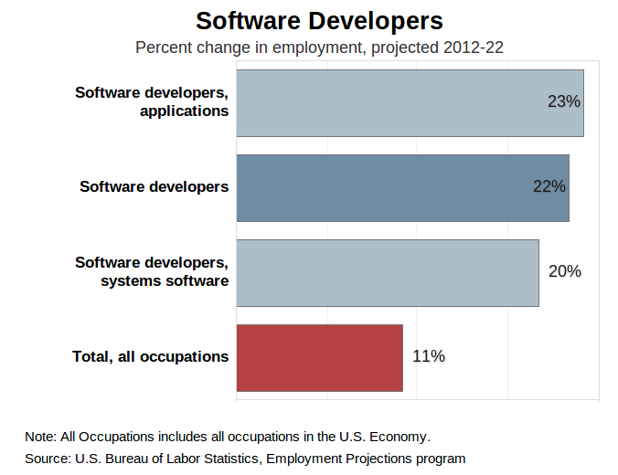
GROWTH PROJECTIONS

Slide 19
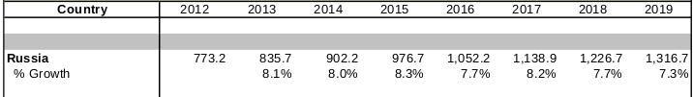
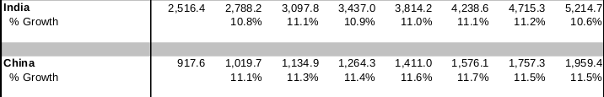
GROWTH PROJECTIONS

Slide 20
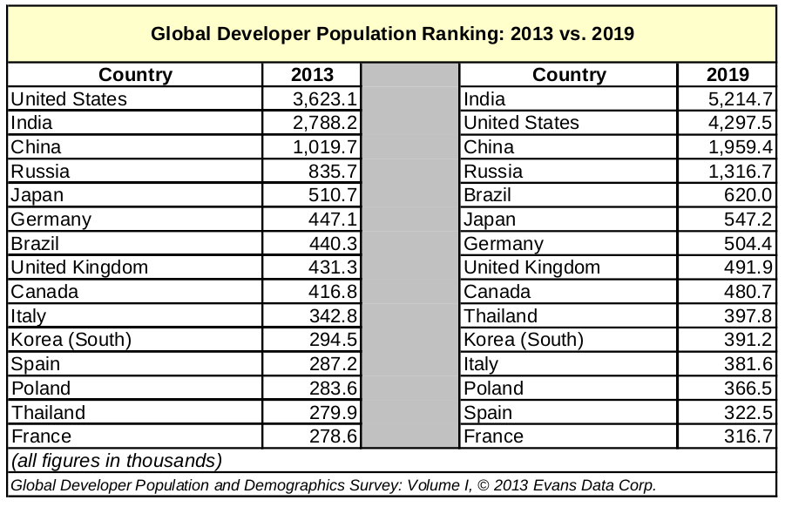
FORECAST 2013-2019

Slide 21
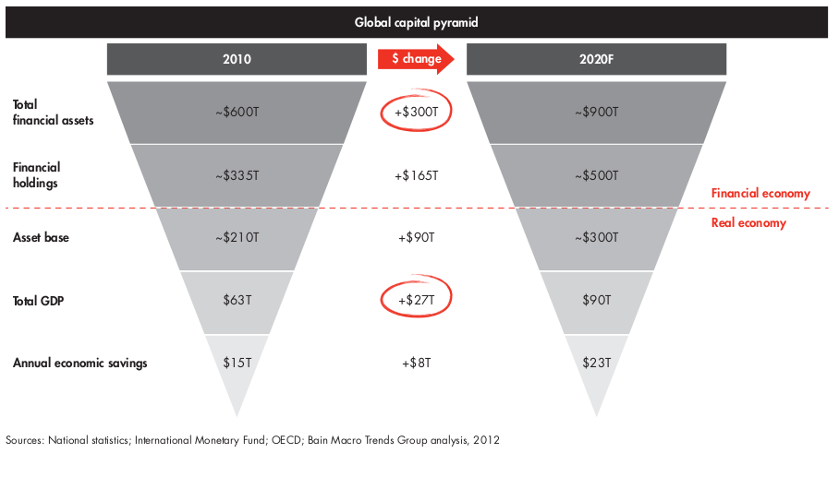
SPOOKY AS SHIT

Slide 22
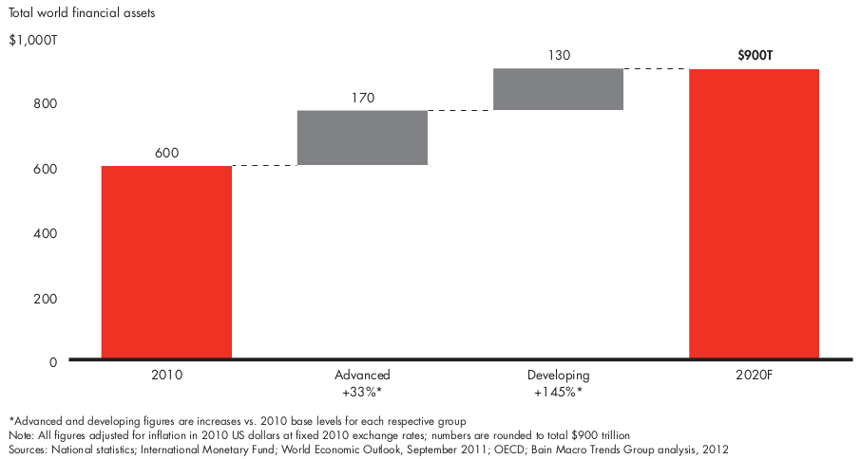
A WORLD AWASH WITH MONEY

Slide 23

PULL QUOTE

Slide 24
THANK YOU
Github.com/RobSpectre/Talks
www.brooklynhacker.com
@dN0t – rob@twilio.com

